Slide 1
Basics of Communication and Transmission Media
Notes:
Let’s try to understand basic concepts of communication as well as basics of transmission media… So basics of Communication and transmission media..

Slide 2
Objectives
At the end of this session, you will be able to:
  Understand the signal and its characteristics
  Understand difference between Analogue and Digital signal
  Draw transmission medium classification
  Draw the composition of transmission media used in communication and list its features
  List the advantages of optical fiber communication
  Draw wireless frequency spectrum along with application wise spectrum distribution
CONFIDENTIAL© Copyright 2008 Tech Mahindra Limited

Slide 3
Agenda
Signal characteristics
Signal – Analogue and Digital
Transmission Media classification and features
Fiber optic: Pros and Cons
Frequency spectrum and applications
CONFIDENTIAL© Copyright 2008 Tech Mahindra Limited

Slide 4
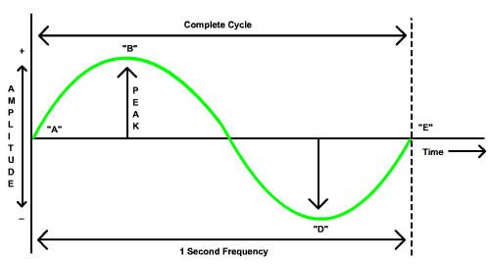
Signal
CONFIDENTIAL© Copyright 2008 Tech Mahindra Limited
Notes:
Everything is communication evolves around a signal…so let’s try to understand more details about the signal…By the way there are two types of signals…one is called analog signal and another is called digital signal…Under analog signal category we have further classification such as periodic signal …the one which is repetative in nature and aperiodic i.e. random signal…
As said early…periodic signal is the one where there is repetation of a signal which is happening after a certain interval of a time…on the contrary in case of aperiodic signal there is no such phenomenon called repeatation…Rather random signals would come under this category…
What is shown in the front is a typical periodic signal called sine wave which all of us are aware of …
Every analog signal has which a periodic signal has got three important characterisgtics – Number 1 …Amplitude, Number 2 …time period of the signal which indirectly denotes the Frequency and Number 3 …Phase…
First and foremost important characteristics of a signal is Amplitude or strength…More is amplitude …more will be peak value and more peak-to-peak value…
Now in this case this particular signal is getting repeated only once in one second …by the way frequency is nothing but number of repeations of signal per second and the unit of freq. is Hz. Because the above signal is getting repeated once we call the frequency of this signal as 1 Hz..But is this signal would have repeated 1000 times …the freq. would have been 1000 Hz or so called 1Khz. On similar fashion, 10 rest to 6 times repeatation in one second gives rise to frequency of 1 Mhz…By the way, if number of repetations are more then the time period of one signal becomes less…so needless to say that frequency is time period of a signal are inversely proportional. More freqency …less time period and vice-varsa…
And the last characteristics is a phase….which talks about where is signal starting…In the present case, signal starts at 0 that is why we say sine of 0 as 0 but in case of COSINE signal it starts at 90…this is called phase of a signal
So the three important attributes of a signal are – amplitude , frequency and phase and one can change one or more of these characteristics…

Slide 5
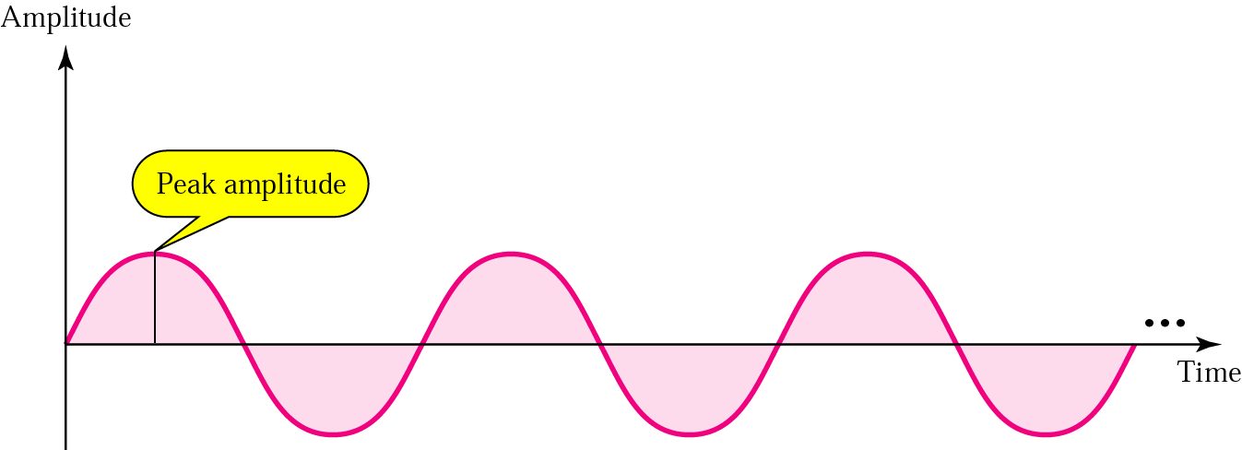
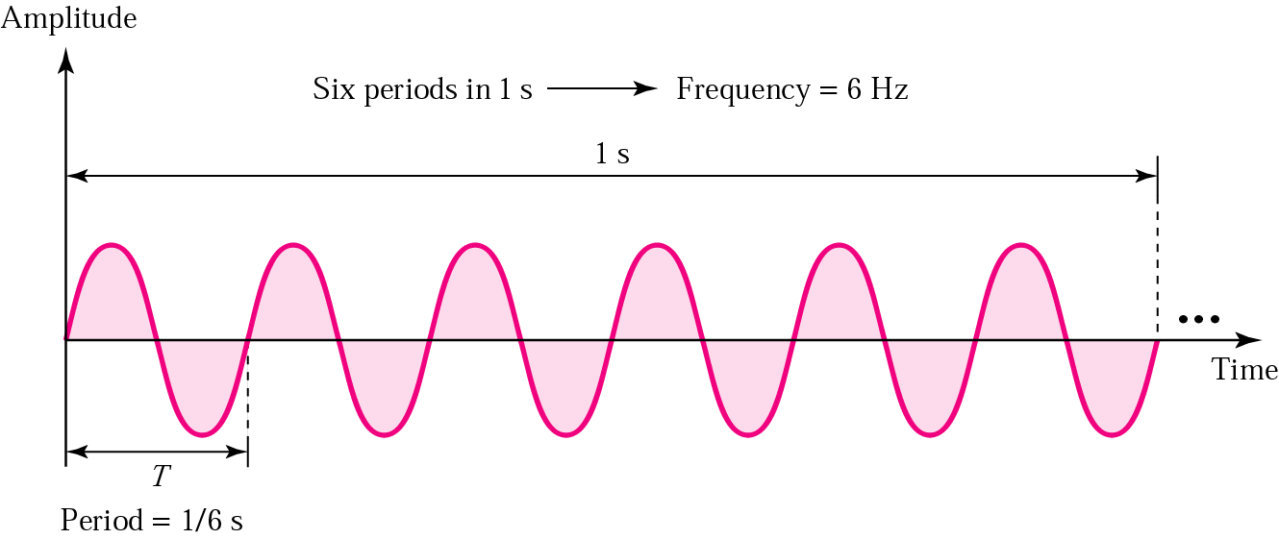
Analog Signal: Amplitude and Frequency
CONFIDENTIAL© Copyright 2008 Tech Mahindra Limited
Notes:
Shown in the figure are two analog periodic signals of different amplitude and frequency…Frequency of signal drawn above is less than the one shown below. Frequency of signal shown below is 6 Hz because it is repeating 6 times a second…

Slide 6
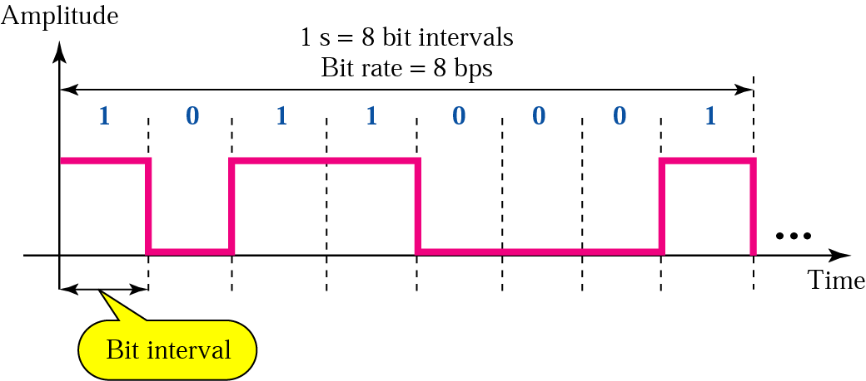
Digital Signal: Bit Rate and Bit Interval
CONFIDENTIAL© Copyright 2008 Tech Mahindra Limited
Notes:
This is a typical digitals signal…And unlike analog signal which has infinite amplitude variations , digital signal has only two variations and that is why it is also referred as BINARY signal…
Here you can have amplitude either as 5 volts represented as 1 or 0 volts represented as 0…By the way, here I am taking about TTL level…IN TTL , voltage 5 corresponds to representation 1 and voltage 0 corresponds to representation 0…
A time period for which a particular bit is on or off is called as BIT INTERVAL…It is possible to have bit interval being different but let’s not go that complexity for the time being…In the case shown above, bit interval is same…Now..number of bits which are tranmitted in 1 second is called Bits Per Second or BPS. It is called bit rate…In this case bit rate is 8 bps… Again if you reduce the bit interval , bit rate will be more and vice-varsa…
BPS in digital signal is equivalent to frequency in analog signal..
Now a days we have a CPU of the order of GHz where clock frequency is of the order of 10 rest to 9 per second…
10 rest to 12 is called Tera Hz…

Slide 7
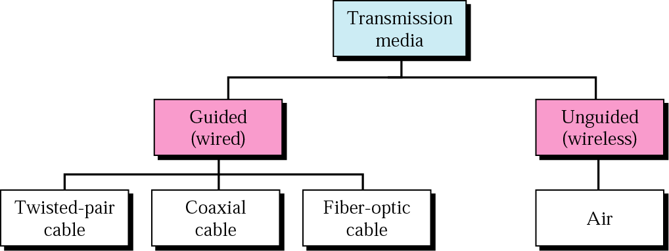
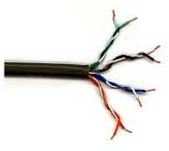
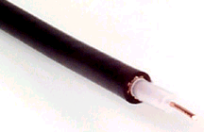
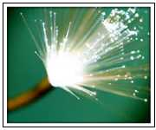
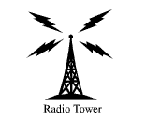
Transmission Media
CONFIDENTIAL© Copyright 2008 Tech Mahindra Limited
Notes:
Now lets begin with an important topic called transmission media…
These are the one which will carry the signals…
Classification is as shown in the figure…Guided transmission medium or so called Wired and un-guided or wireless…
Under guided transmission medium we have further classification such as twisted pair , co-axial and fiber where as unguided medium happens to be an air…In twisted pair and coaxial cable data is transferred in terms of electrical signals, in fiber it is transferred in the form if light whereas in air electromagnetic waves are transferred….
By the way, guided medium is also called bounded medium with unguided as unbounded…

Slide 8
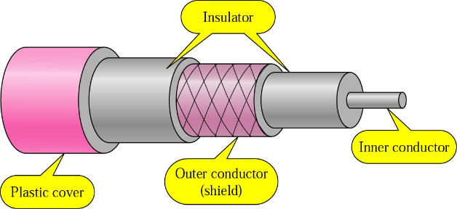
Transmission Medium – Coaxial Cable
Category | Impedance | Use
RG-59 | 75 Ω | Cable TV
RG-58 | 50 Ω | Thin Ethernet
RG-11 | 50 Ω | Thick Ethernet
CONFIDENTIAL© Copyright 2008 Tech Mahindra Limited
Notes:
Let’s start with co-axial cable…
Explain construction… Shown in the figure is a typical structure of a co-axial cable…
……
It is called co-axial because…
Category and use..
Cable tv v/s computer network cable…

Slide 9
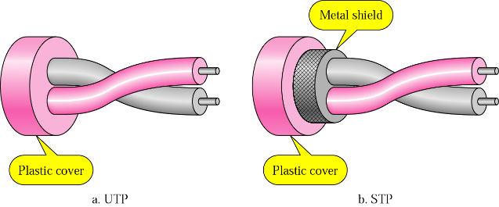
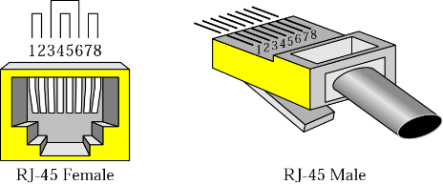
Transmission Medium – UTP and STP
CONFIDENTIAL© Copyright 2008 Tech Mahindra Limited

Slide 10
Twisted Pair Categories
Category | Bandwidth | Data Rate | Digital/Analog | Use
1 | very low | < 100 kbps | Analog | Telephone
2 | < 2 MHz | 2 Mbps | Analog/digital | T-1 lines
3 | 16 MHz | 10 Mbps | Digital | LANs
4 | 20 MHz | 20 Mbps | Digital | LANs
5 | 100 MHz | 100 Mbps | Digital | LANs
6 | 200 MHz | 200 Mbps | Digital | LANs
7 (draft) | 600 MHz | 600 Mbps | Digital | LANs
CONFIDENTIAL© Copyright 2008 Tech Mahindra Limited

Slide 11

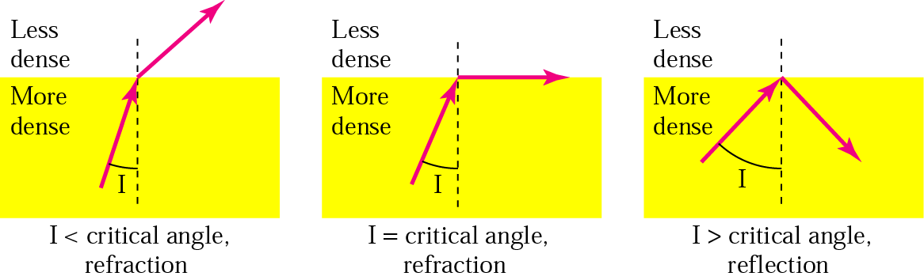
Transmission in Fiber - Optic Cable
Transmits digital signals in the form of pulses of light
Optical carriers are designated according to their transmission capacity
Attenuation is measured in dB/km, which today ranges from 0.2 to 2.0 dB/km
More noise immunity
Critical Angle
CONFIDENTIAL© Copyright 2008 Tech Mahindra Limited
Notes:
Another very interesting transmission medium called Fiber optic cable…
Transmits digital signals in the form of pulses of light…so need a converter to convert signal in analog form to digital and then to light while sending and reverse process while receiving….
Electical → light …laser .. Light emitting diode
light → Electrical …photo diodes , photo transistors..
Communication medium is glass

Slide 12
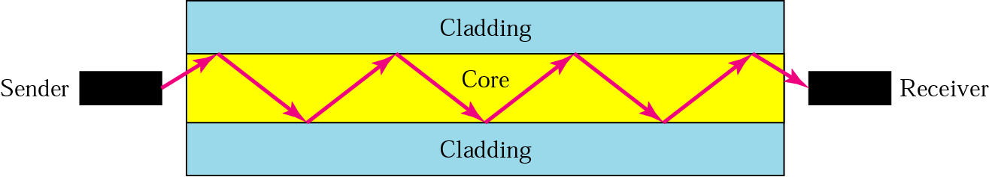
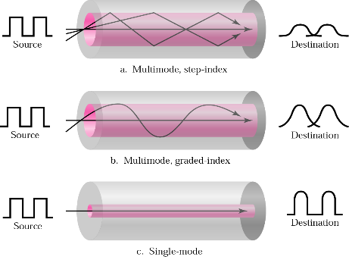
Transmission in Fiber - Optic Cable
CONFIDENTIAL© Copyright 2008 Tech Mahindra Limited
Notes:
Multi Mode Cable:Multiple beam of light source move thro core in different paths.
Multimode Step Index:Has the density of core remaining constant from center to edges.Sice there is abrupt change in density at the edge due to lower density thus causing a step.This abruptness causes the distortion.
Multimode Graded Index: Here the density of core varies, highest at the center & lowest at the edge. This variable density causes the light to converge at regular intervals. Thus if this convergence is at the receiver the received signal will have better distortion figures compared to Step index.
Single Mode: In this mode the core is manufactured with lower density or index of refraction with lesser diameter of core. This decrease in density results in propagation of beams almost horizontal, thus delay & distortion is minimum. All beams arrive at destination together.Most preferred for long distance communication, but most expensive.

Slide 13
Fiber : Pros and Cons
Major advantages of Optical Fiber are :
  less Attenuation
  more bandwidth
  data security
  least reaction to chemicals & noise immunity
  storage is Simpler
BUT
  Needs skilled labor to handle joints & each joint adds to losses
  More expensive
CONFIDENTIAL© Copyright 2008 Tech Mahindra Limited

Slide 14
Frequencies for Communication
VLF = Very Low Frequency
LF = Low Frequency (Submarine)
MF = Medium Frequency (AM)
HF = High Frequency (AM)
VHF = Very High Frequency (TV, Mobile)
twisted pair
coax cable
optical transmission
1 Mm
300 Hz
10 km
30 kHz
100 m
3 MHz
1 m
300 MHz
10 mm
30 GHz
100 μm
3 THz
1 μm
300 THz
VLF`
LF
MF
HF
VHF
UHF
SHF
EHF
infrared
visible light
UV
UHF = Ultra High Frequency (TV, Mobile)
SHF = Super High Frequency (Satellite)
EHF = Extra High Frequency(Satellite)
OPTICAL = Optical Fiber links (IR)
UV = Ultraviolet Light
CONFIDENTIAL© Copyright 2008 Tech Mahindra Limited

Slide 15
Summary
In this session, we have learned:
  Signal – Analog and Digital, their characteristics
  Difference between Analogue and Digital signal
  Classification of transmission media
  Composition, characteristic features and speed/bandwidth of bounded media such as coaxial and twisted pair copper and fiber
  Advantage of fiber optic communication medium over others
  Wireless frequency spectrum with application wise spectrum distribution
CONFIDENTIAL© Copyright 2008 Tech Mahindra Limited

Slide 16
Thank You

